Slide 1
Working through questions and answers
How can we provide hints to each other?

Slide 2
Steps after reading the passage:
Read the question—do you know the answer?
Check out the hint/return to the passage. Try your answer again; do you still think you selected the correct option? Revise if you need to.
Check your answer.

Slide 3
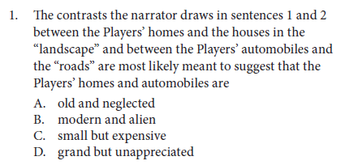
STEP 1: Read the question. Do you know the answer?

Slide 4
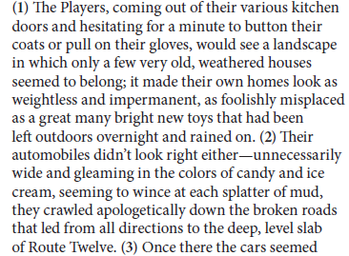
STEP 2: Check for hints; does your answer still make sense?
HINT: Think about how the landscape houses and roads are described; they are linked. Then, since the question asks about CONTRASTS, how are the Players’ homes and cares different from those?

Slide 5
Did you record your answer?
Now go to the next slide to check it.

Slide 6
STEP 3: Check your answer.
No---those words mean the same; prompt asks for contrasts
Yes! The houses/cars are new, “shiny” and “misplaced” amidst the old town
No---size is never indicated
No---they may seem grand, but the passage does not mention any hint of whether people appreciate one over the other

Slide 7
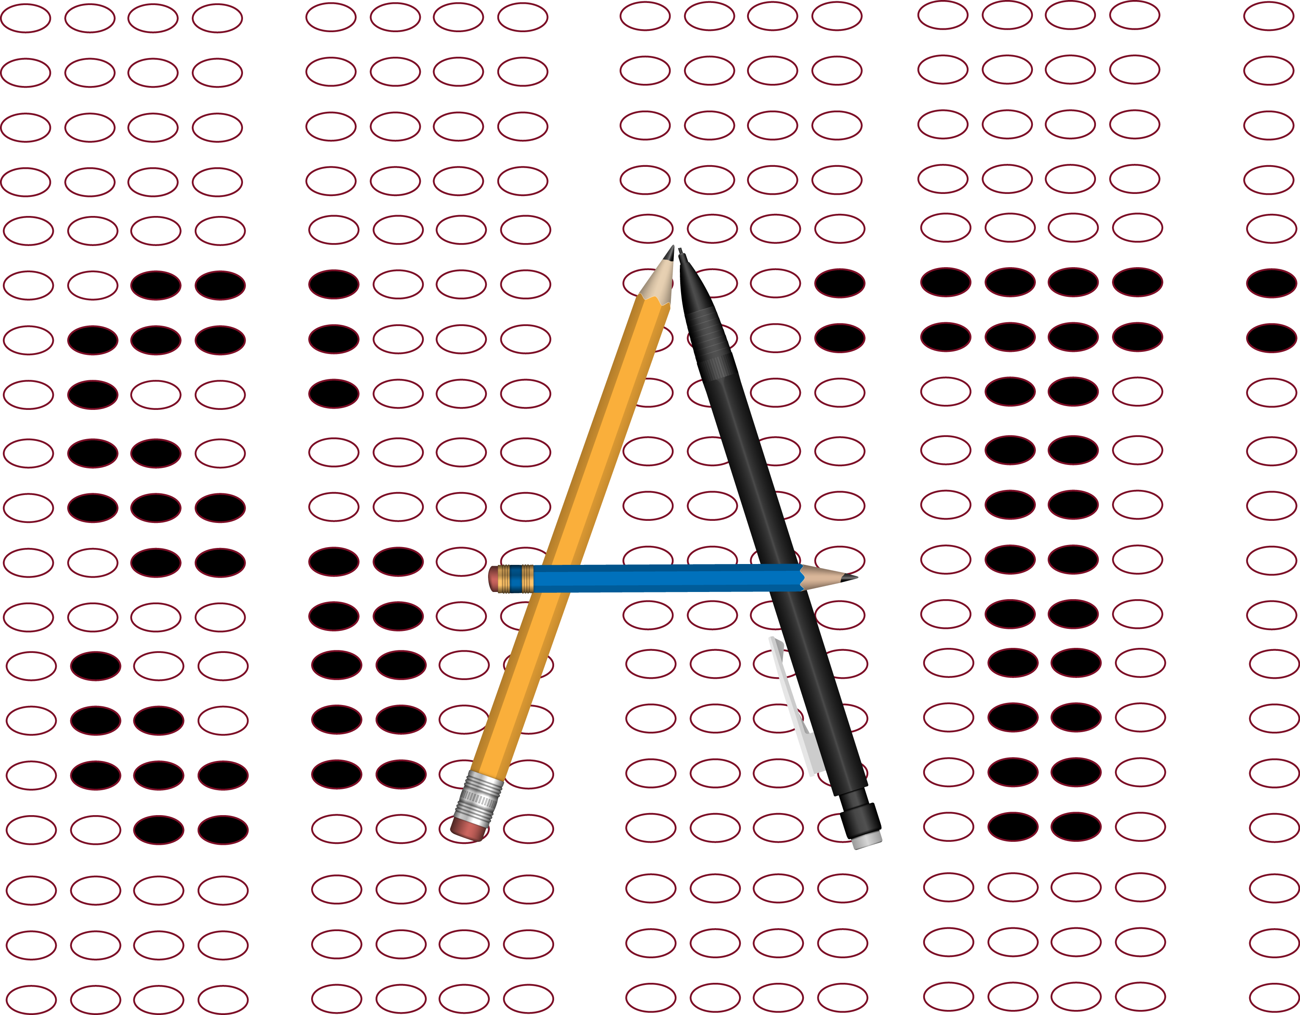
Try the questions 2, 3, and 4:
Try to choose an answer
Look at hints and revise answer if needed
Check answer/look at explanations

Slide 8
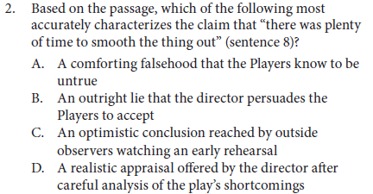

Slide 9
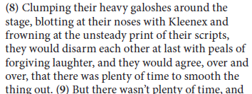
HINT: Think about the kind of laughing they do; why does it matter they “agree” with each other?

Slide 10
Did you record your answer?
Now go to the next slide to check it.

Slide 11
Yes! They try to break the tension and reassure each other, even though they know they are in trouble, which the start of the next sentence (9) indicates. Additionally, look at the parts in red; things aren’t going well.
The director isn’t mentioned; this is about how the actors treat each other.
No “outside observers” are mentioned.
There is NOT plenty of time so the laughter and agreement aren’t realistic.

Slide 12
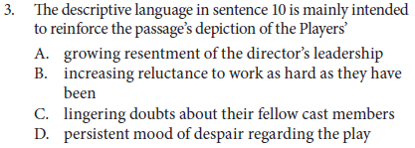

Slide 13
(10): Long after the time had come for what the director called “really getting this thing off the ground: really making it happen, it remained a static, shapeless, inhumanly heavy weight; time and time again they read the promise of failure in each other’s eyes, in the apologetic nods and smiles of their parting and the spastic haste with which they broke for their cars and drove home to whatever older, less explicit promises of failure might lie in wait for them there.
HINT: Look at that diction (word choice) in the sentence noted. What is this rehearsal like? How do the people leave?

Slide 14
Did you record your answer?
Now go to the next slide to check it.

Slide 15
(10): Long after the time had come for what the director called “really getting this thing off the ground: really making it happen, it remained a static, shapeless, inhumanly heavy weight; time and time again they read the promise of failure in each other’s eyes, in the apologetic nods and smiles of their parting and the spastic haste with which they broke for their cars and drove home to whatever older, less explicit promises of failure might lie in wait for them there.
no—word choice indicates frustration at their situation, not resentment at the director
No-it’s not there is reluctance; there is frustration
There is self-awareness that they themselves aren’t being successful
Yes! That diction (word choice) speaks of a problematic production with little hope of success

Slide 16
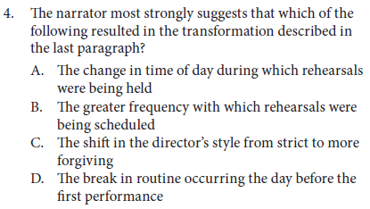

Slide 17
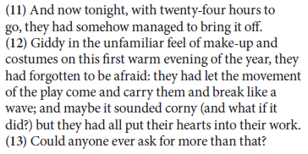
HINT: How does this evening of the performance compare/contrast to the previous rehearsal?

Slide 18
Did you record your answer?
Now go to the next slide to check it.

Slide 19
no—we don’t know what time of day it was during rehearsal
No-the passage hints that “doubling” and “redoubling” rehearsals didn’t seem to matter.
The director is never mentioned.
Yes! Look at the differences: “UNFAMILIAR FEEL,” and “FIRST WARM EVENING” and “FORGOT TO BE AFRAID”

